Slide 1
PROJECT REPORT
INTRODUCTION
EduConnect Learning Center is a virtual platform designed to provide learners with a wide range of educational resources and opportunities. Whether you're a student, a working professional, or someone looking to expand their knowledge, EduConnect Learning Center aims to offer a diverse array of courses and learning materials to help you achieve your educational and career goals.

Slide 2
Preparation and Maintanence of ZOHO Books for Dream Homes Realty
Dream Homes Realty, a construction company, uses Zoho Books to track project expenses,
manage subcontractor payments, and handle invoicing. They can generate estimates and
invoices for clients, track job costing, and monitor the profitability of each project.
Zoho Books provides them with financial insights to make informed decisions.

Slide 3
PROBLEM DEFINITION & DESIGN THINKING
EduConnect Learning Center is facing a challenge where it has seen a decline in user engagement and a decrease in the number of course enrollments over the past year. This problem may be attributed to various factors, including increased competition from other online learning platforms, changing user preferences, and difficulties in adapting to evolving educational technologies and trends. To ensure the sustainability and growth of EduConnect Learning Center, addressing this issue is crucial.
2.1 Empathy Map
2.2 Ideation & Brainstroming Map

Slide 4
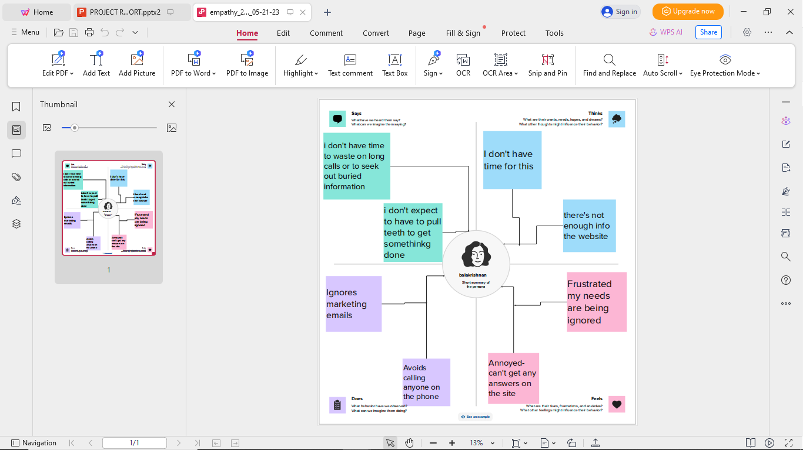
Empathy Map

Slide 5
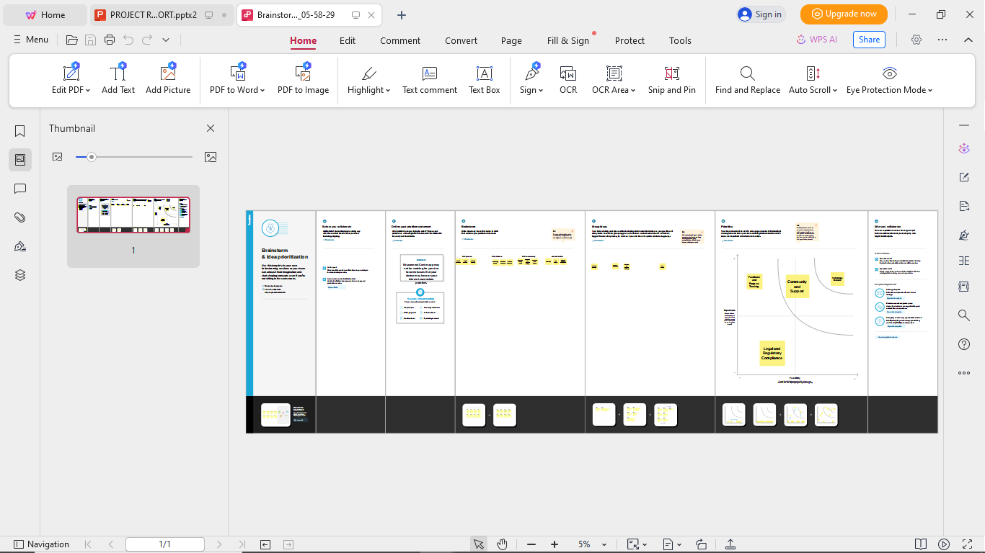
RESULT Output: 1.Company Name Creation:

Slide 6
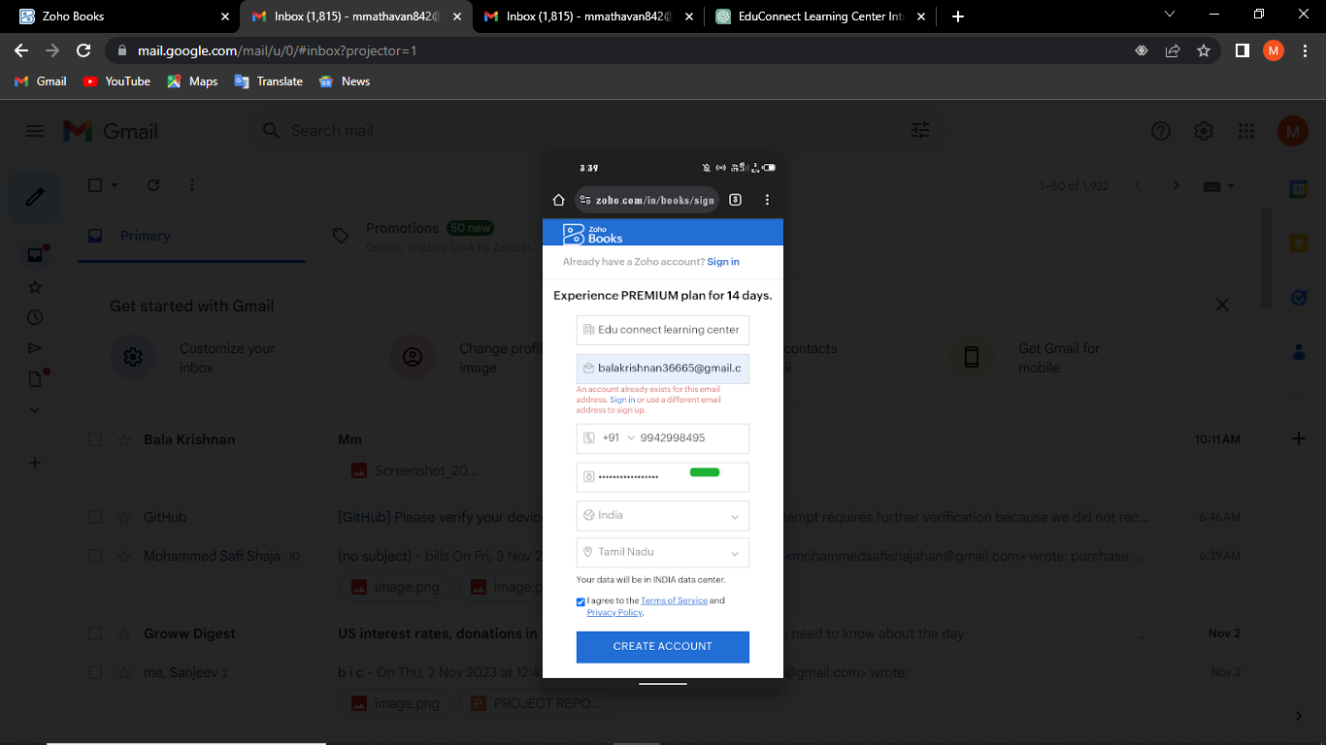
We have to create our Company Name And other Details From Below Zohobooks
2. Item Creation: We have to create items, Such as
➢ Item names
➢ Units
➢ HSN/SAC
➢ Selling info/Purchase info
➢ Tax Rate

Slide 7
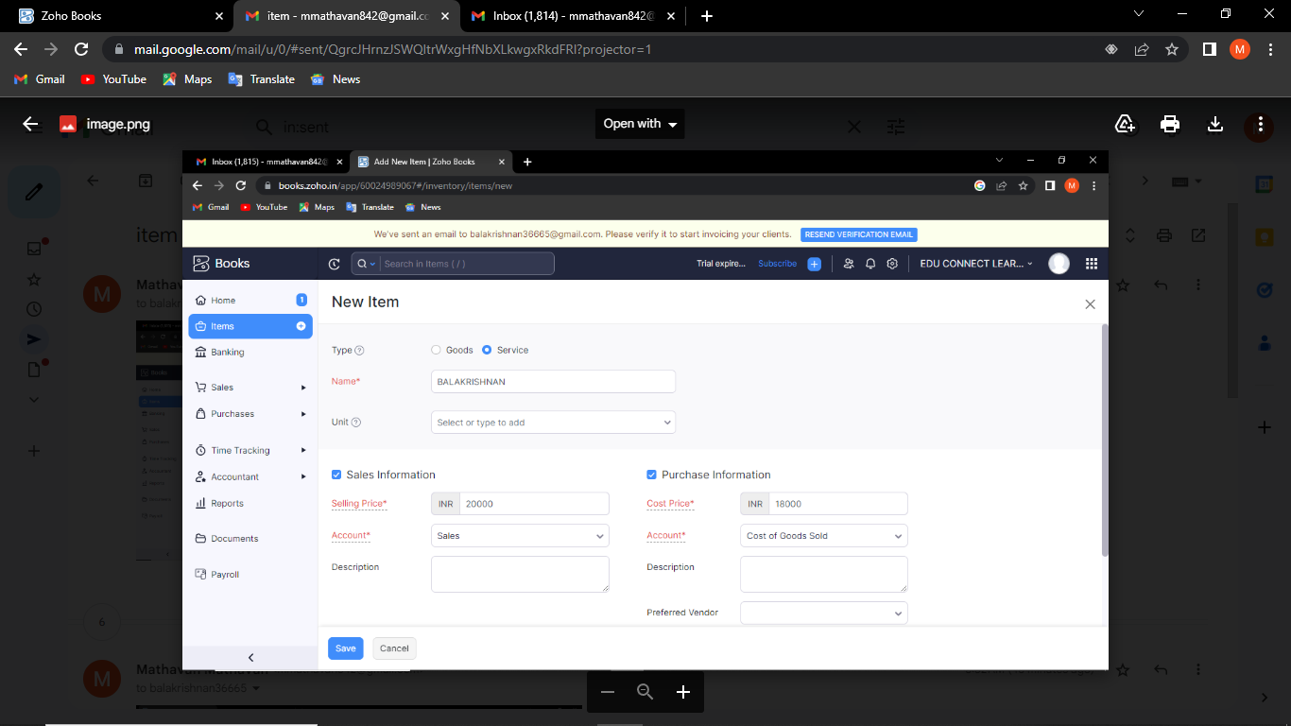
Item Creation

Slide 8
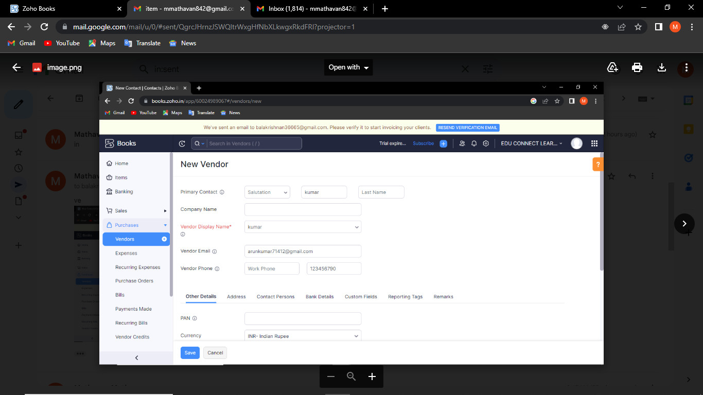
3. Vendor Creation: Now create Vendor in books from navigator panel Create New Vendor For example ➢property sales person

Slide 9
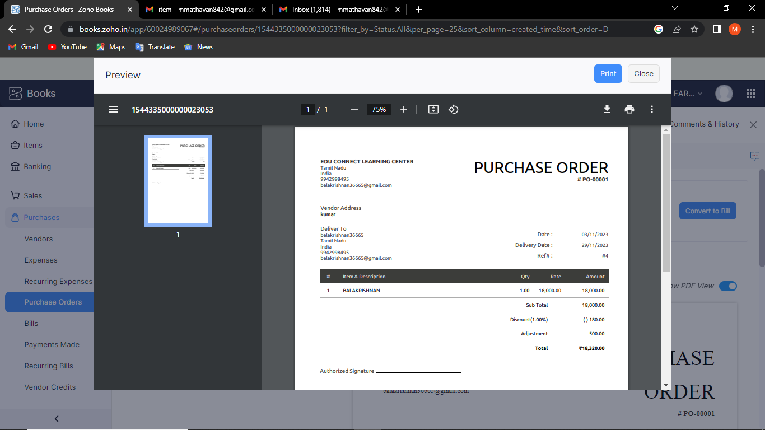
4. Purchase Order:

Slide 10
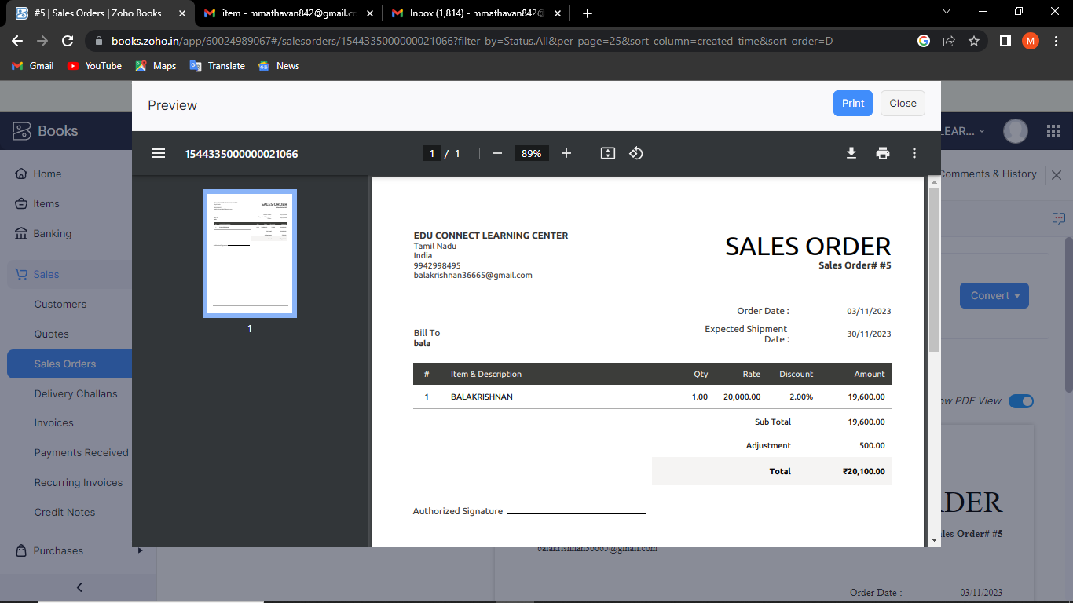
5. Sales Order:

Slide 11
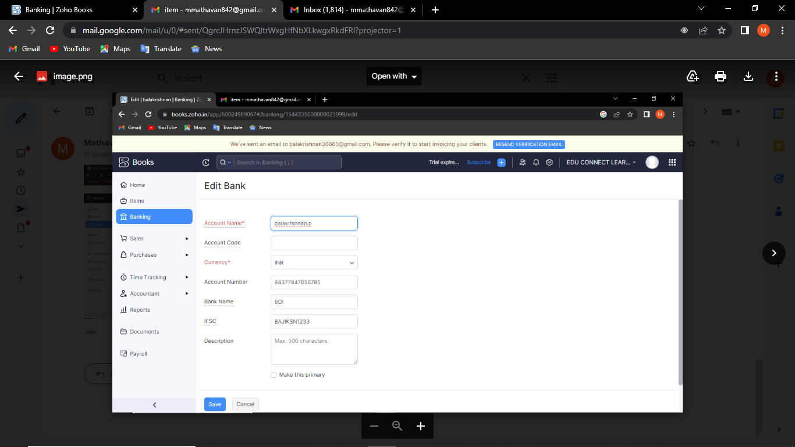
6.Payment to Bank Details:

Slide 12
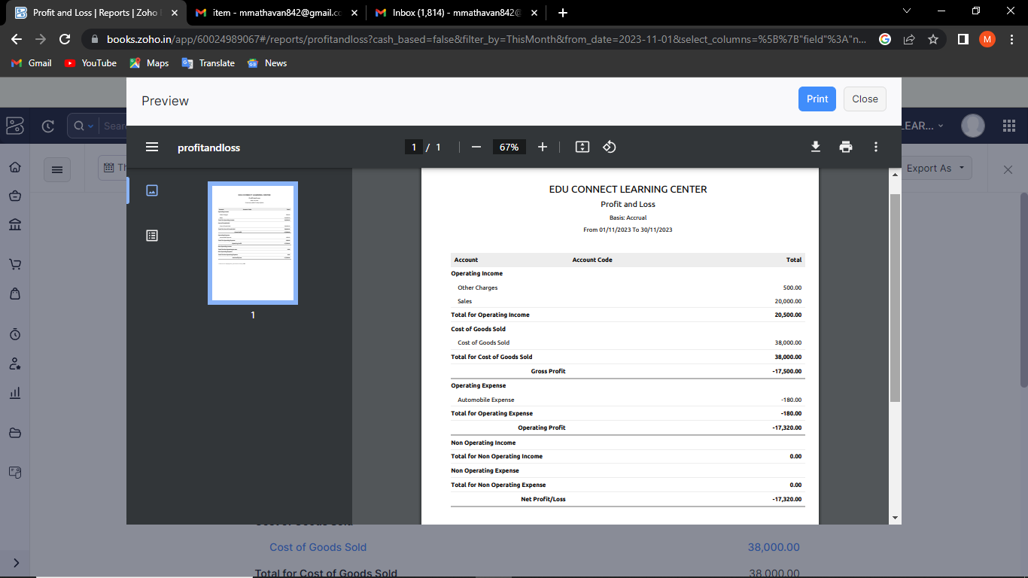
7. Profit and loss Account\ Balance Sheet\GST Report :

Slide 13
4. ADVANTAGE & DISADANTAGE: ADVANTAGE: Easy for Managing day to day activities. DISADVANTAGE: Missing New Version. 5. APPLICATION: This application used to maintain the company details and ledger accounts, profit and loss Account and Balance sheet of the Edu connect learning center .
6 CONCLUSION:
EduConnect Learning Center, a dynamic online educational platform, has embarked on a journey to address the challenges it faced regarding declining user engagement and course enrollments.
7 FUTURE SCOPE:
The future scope for EduConnect Learning Center is promising, and it envisions several areas of growth and development to better serve its learners and remain competitive in the dynamic field of online education. Here are some potential directions for the future of EduConnect Learning Center
8 APPENDIX:
➢ Approved development
➢ Future Assessment
➢ Plan of development
➢ Development Purpose
➢ Interpretation

